Slide 1
JavaSpecs
A Web-Based Platform for Java Specifications
Team May1639
Arik Coats | Evan Dye | Robert Kloster

Slide 2
Specifications
What are specifications?
Formal contract between the software (provider) and the user (client)
Defines code behavior: preconditions, postconditions, invariants, etc.
Similar to formatted pseudo code documentation
Benefits
Avoid more errors while coding
Faster coding and debugging.
Reliable, testable code.
/*@
requires 0 <= amount;
ensures \result == balance
&& balance == \old(balance - amount) ;
@*/
public int withdraw_amount(int amount)
{
...
}
Notes:
Simply put, specifications are an established agreement between a server and its client(s). Which, in our case, happens to mean between commonly used software and the entities using it; customer, developer, other software, you name it.
Behavioral specifications are pretty straightforward; they’re specifications as to how the code behaves.
We’re focusing on formal behavioral specifications; behavioral specifications which are organized in a structured, machine-understandable format, much like a code representation of the documentation.
If such information were available to test automation software, we can achieve both greater error detection rates and faster programming and debugging rates, all of which leads to more testable and reliable software.
So what’s the problem?

Slide 3
Problem Statement
Despite their usefulness, there is a severe lack of formal specifications for common software libraries. There are several reasons for this:
In order to specify your software, all of the code the software relies on must be specified as well.
Formal specifications can be difficult to write and may require uncommon knowledge.
Writing formal specifications can be time consuming, so many companies do not consider them worthwhile or cost effective.
Notes:
The issue is that, despite this great potential, formal behavioral specifications are scarce, especially for some of the most common software libraries, for several reasons.
Firstly, in order to truly and properly create formal behavioral specifications for a piece of software, all inner code that the software relies on needs to be specified as well.
Secondly, creating non-trivial formal behavioral specifications can prove quite difficult, even if you have intimate knowledge regarding the code’s structure.
Finally, creating such specifications can be time consuming, so many companies don’t grant them much consideration, despite their inherent promise of quality gained and time saved in the long run.

Slide 4
Purpose of project
The implementation and development of a Q&A web forum dedicated to the creation, discussion, and refinement of formal behavioral specifications for commonly used Java libraries.

Slide 5
Solution Plan for CprE/SE 492
Construct a Q&A forum for software developers to view, discuss, create, and approve specifications, and meets the following requirements:
The forum will contain the source code for classes and methods of commonly used Java libraries for easy reference.
The forum will offer users meaningful, related posts from Stack Overflow.
The forum will provide a RESTful API for easy access of data by 3rd party systems.
Notes:
JavaSpecs was designed with these three objectives in mind;
Receive and parse source code libraries, and display the code to the user.
Provide the user with meaningful posts to from Stack Overflow that relate to the currently viewed source code.
Hosts a RESTful API for 3rd-party software to access the information our website tracks.

Slide 6
We Used:
Question2Answer (Q2A): Online question-and-answer web forum structure (Version 2).
MyBB: Online web forum structure (Version 1).
phpMyAdmin: Database access and maintenance
MySQL: Database language
Primary Languages: HTML, PHP, MySQL, JavaScript, Java

Slide 7
Major Challenges
Transitioning from MyBB to Question2Answer
MyBB: too restrictive, not suited to our purposes
Question2Answer: lightweight, easy to design for and has a better format
Transitioned existing work and developed new features within a week to justify the transition to our advisor/client
Acquiring new web server virtual machine (VM)
Project file space lacked command line access, could not implement several major features
Developed and tested features locally
Gathered requirements for a web server and submitted them in a request to the Electronics and Technology Group
Migrated project to new web server and integrated locally developed features into the website
Notes:
Problem 1: MyBB
Original requirements specified a ‘web forum’; MyBB was chosen
Requirements changed to a Q&A website; MyBB had significant differences from the new requirements
Solution: Question2Answer
Fits current requirements for a Q&A site, more flexibility in adaptation
Implementation Time: <= 1 week
Problem 2: Server Space
Originally assigned a server space for project website
Required command-line access to compile and execute library-parsing code on the server; server space did not offer this functionality
Solution 2: Virtual Machine
Requisitioned new VM from ETG, migrated project work over; command-line access granted.
Implementation Time: >= 1 week

Slide 8
Source Code Extraction
Researched many possible solutions to extract source code information.
Unused solution: GrepCode API
Limited API can not extract sufficient data.
Cannot be used in an automated system.
Unused solution: Java Reflection API
Limited available data for extraction.
Tedious manual parsing.
Difficult to implement for multiple java files.
Chosen solution: use third party parser
Eclipse JDT, Abstract Syntax Tree
JDBC, MySQL

Slide 9
Parser
Searches directory for Java files
Parse source code into component parts using the Eclipse JDT library
Insert parsed source code data into forum database using JDBC

Slide 10
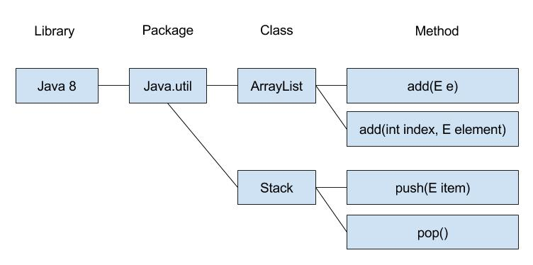
Navigation
Navigate library structure for supported libraries
View source code
Navigation bar maintains a path with clickable links similar to how a file explorer maintains a path to the current directory.

Slide 11
Navigation
Challenge: MyBB
No feasible way to implement navigation on MyBB
Attempted directly inserting forums into database, nearly broke website.
Solution: Question2Answer (Q2A)
Lightweight, non restrictive platform similar to StackExchange
Given a week to transition website to Q2A and prove that it is feasible.
Set up Q2A and developed navigation system using AJAX and PHP.

Slide 12
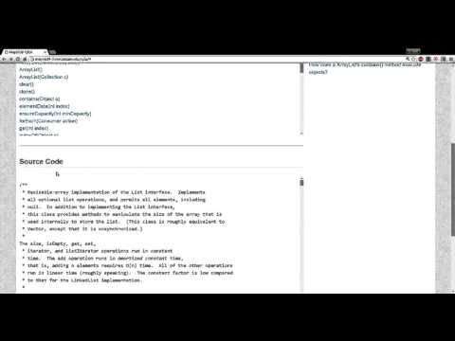
Navigation Demo

Slide 13


Search
Search for name of library, package, class or method to quickly find the information you want.
Returns list of paths to matches with working links for each item.
On selection, navigates to location and updates main navigation bar

Slide 14
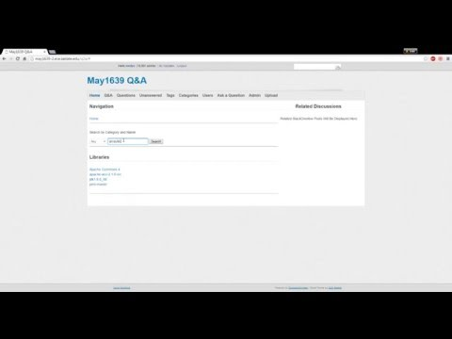
Search Demo

Slide 15
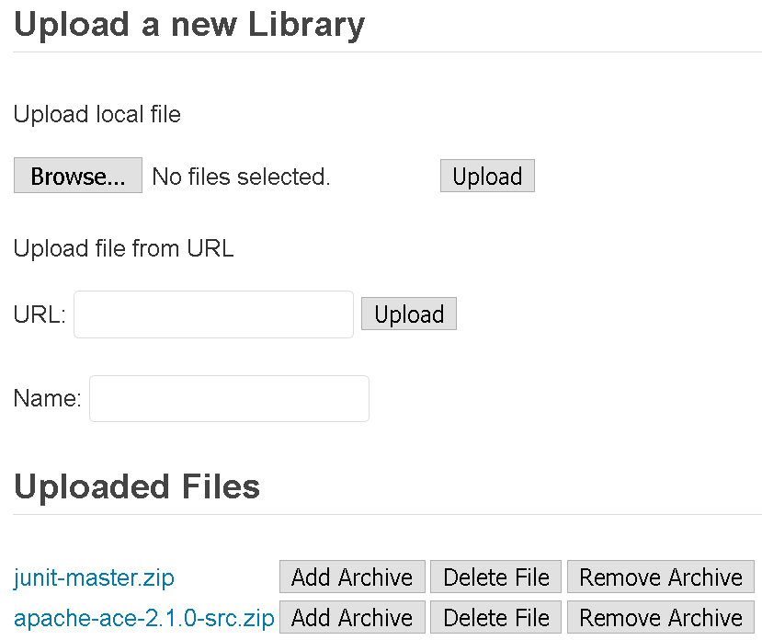
Upload
Allow admins to upload new libraries from:
A file on the user’s machine
A url to a downloadable archive
Display all uploaded files and provide buttons to:
Download the file
Extract and parse source code into database
Remove library from database
Delete file

Slide 16
Upload
Challenges: Project File Space
No Command line access: Java
PHP file upload restrictions
Solutions
XAMPP: Developed upload system locally
Web Server: Integrated upload system into website on our new project web server

Slide 17
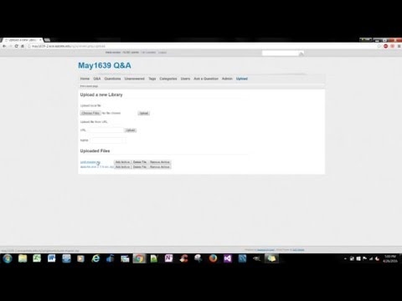
Upload Demo

Slide 18
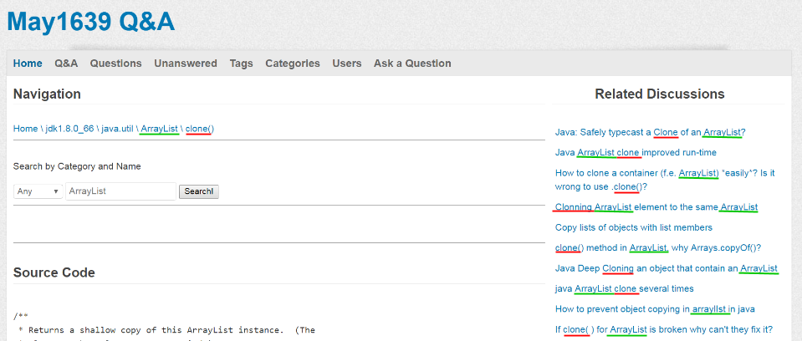
Related Posts: Goal
For each class/method:
Generate a list of links to related Stack Overflow posts.
Purpose:
Provide resources to research the class/method under discussion.

Slide 19
Related Posts: Post Information
Stack Exchange Data Dumps provide all necessary information.
Stack Overflow Posts XML Data (~36 GB)
Parsing the Information
Used PHP XMLReader for sequential parsing.
Parsed necessary post information into a database, including:
Title
Tags
Score
Accepted Answers
Created a dictionary of all title words and tags.

Slide 20
Related Posts: Ranking
Consider relevant post information for a given class or method:
Tags - the class and/or method name is a tag for a question.
Title - the class and/or method name is in the title of a question.
View Count - indicates popular question, likely with reliable answers.
Score - indicates quality question or answer.
Rank potentially relevant posts.
Rank = C₁* Normalize(R) + C₂ * Normalize(T) + C₃ * Normalize(V) + C₄ * Normalize(S)
R = Number of relevant tags (i.e. class, method) for a question.
T = Number of relevant words (i.e. class, method) in a post question.
V = View count of a question.
S = Score of a question.
Where C_{i} is a weighted constant.

Slide 21
Related Posts: Challenges
Stack Exchange API Method
Problem
300 queries per day limit per IP (10,000 with Key).
30 requests per second limit per IP.
Expensive to parse all interesting content in real time.
Solution - Stack Exchange Data Dump
Store information in a local database.
Provides easy access to any required information.
Stack Exchange Data Dump Method
Problem
Expensive to search through millions of posts.
Proposed Solution - Pre-Rank Posts
For each class/method, determine related posts in advance.
Store ranks in database.

Slide 22
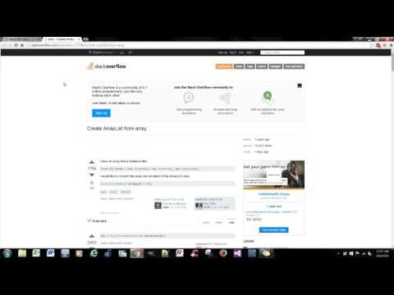

Slide 23
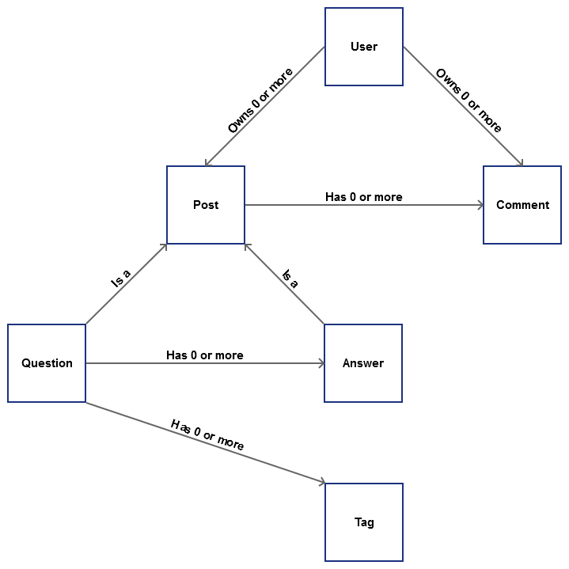
API Implementation: Goal
Provide 3rd-party software with information from the database about:
Questions | Answers
Posts | Comments
Users | Tags
through a RESTful API.
Notes:
The last of our key requirements was that JavaSpecs can provide 3rd-party software with the information that our site tracks. The reason being is that there’s currently research on specification inference going on at ISU, and the data that JavaSpecs gathers and tracks will prove valuable to them.
Our API allows users to request for and receive a JSON-formatted list of callable data objects. At the moment, the API supports 6 different types; Users, Posts, Comments, Questions, Answers, or Tags. A User may have multiple Posts and/or Comments associated with it, a Post is either a Question or an Answer and may have multiple Comments associated with it, and a Question may have multiple Answers and/or Tags associated with it. The API system allows for easy integration of additional callable data object types via a standardized modular design.

Slide 24
API Implementation: Challenges and Solutions
Challenge: Designed after StackExchange
Majority of StackExchange API calls didn’t apply for the project’s intended use
Limited/inflexible searching and sorting abilities
Solutions
Combined and condensed API calls by returned type of data
Allows for easy integration for new API calls in the future
Designed input structure after GitHub API repository search call
Significantly increased flexibility of searching and sorting
Notes:
Problem: Input/Output structure
Original objective; develop API that emulates the StackExchange API
Many StackExchange Queries were not applicable for our API’s purposes
Filtering and sorting of results were extremely limited
Solutions:
Coalesced API calls down to 6 types; one for each callable data object
Modular design allows easy integration of new callable data objects
Partially modeled input structure after the ‘search repositories’ API call from GitHub
Allowed for far more powerful, complex and flexible searching/sorting parameters

Slide 25
API Implementation: Search Functionality
Integer and Datetime Variables
Comparative conditions: =, !=, <, >, <=, >=
Range conditions: low_value .. high_value
Boolean Variables
Comparative conditions: true, false
String Variables
Contains conditions: IN, NOT IN
Performed across all string variables by default
Can specify which string variables are included in the search
Notes:
Our API implementation allows users to set any number of minimums, maximums, equal_to values, and/or not_equal_to values for any number of integer and/or date_time variables. Furthermore, users can include any number of search strings by which they can filter the results of any number of string variables. Our modified input design allows for significantly more complex queries than the input structure modeled after the StackExchange API.

Slide 26
API Implementation: Additional Functionality
Sort
Can sort by any number of given variables
Can select either ascending or descending for each sort variable
Pagination
Can set pagesize from 1 - 100 (default is 30)
Can select specific page (default is page 1)
Notes:
In addition, users can sort (and sub-sort) results by any number of variables, and can optionally specify either ASC or DESC for each one. Finally, users are able to limit the number of results at get returned, and can select which page of results that will be returned.

Slide 27
Question Variables
Integer | String | Datetime | Boolean
question_id | title | creation_date | is_answered
owner | body | last_activity_date
view_count | tags | last_edit_date
score
up_vote_count
down_vote_count
answer_count
accepted_answer_id
Notes:
Here we have the variables for a Question type object; let’s take a note of the integer variable `question_id` and the string variable `title`,

Slide 28
http://may1639-2.ece.iastate.edu/q2a/api.php/questions
{
"Items":[
{
"question_id":1,
"title":"Is this forum better?",
...
},
{
"question_id":2,
"title":"Test Question",
...
},
...
]
}

Slide 29
http://may1639-2.ece.iastate.edu/q2a/api.php/questions?conditions=question_id:>2
"Items":[
{
"question_id":3,
"title":"Testing Tags",
...
},
{
"question_id":4,
"title":"How to make Widgets?",
...
},
...
]
}

Slide 30
http://may1639-2.ece.iastate.edu/q2a/api.php/questions?conditions=Widget question_id:>2
{
"Items":[
{
"question_id":4,
"title":"How to make Widgets?",
...
}
]
}

Slide 31
Summary
Specifications: beneficial for testing and quality assurance
Problems: time and knowledge constraints, specification dependencies
JavaSpecs: Q&A web platform for specifications of common Java libraries
Source Code on server
Can upload new libraries
Display helpful posts from StackOverflow
API offers connection between JavaSpecs and data-mining softwares.

Slide 32
Questions?

Slide 33
Resources
Rajan, Hridesh, Tien N. Nguyen, Gary T. Leavens, and Robert Dyer. "Inferring Behavioral Specifications from Large­scale Repositories by Leveraging Collective Intelligence." “37th International Conference on Software Engineering: NIER Track” May 2015, ICSE’15, Florence, Italy.

Slide 34
Misc.
How To Use API?
Manual included in ‘Final Report’ on Project Website Documents page
http://may1639.github.io/documents.html

